Slide 1
Coursework 2016/17

Slide 2
Overview
Build a UWS Study Buddy application
Key functionality :
Enter a new request
Edit an existing request
Algorithm to find potential matches (study buddies)
Display matches

Slide 3
Overview
Work in pairs or individually
Produce a solution to the problem using the suggested 5 step approach
Only move on to next step when current one is complete
Each step should be self-contained (including testing)
Each step has a defined marking scheme
Fully document the process

Slide 4
Submission
Submit to Moodle using the upload link provided
Follow the instructions in the What to Submit section of the coursework document
Each partner must provide his/her own critical appraisal
Submission deadline 23.59hrs on Friday 14th April 2017
Late submissions attract 10% penalty
Submissions made after 23.59 on Friday 21st April will NOT be marked
N.B. If you have a problem uploading via Moodle you MUST email your lecturer, attaching your submission, BEFORE the deadline from your STUDENT EMAIL account.

Slide 5
Step by step
You are advised to build your application in 5 steps
Complete each step before moving on to the next
Marks are awarded for each step – see marking scheme
For each step –
Create a separate folder named (StepX)
Create the StepX.py file
Save all your files (for this step) in this folder
Create a testing plan and sample data - keep a copy in folder
Keep screenshots of outputs of your program as evidence of testing

Slide 6
Step 1
Create a class called Request with appropriate attributes
request ID,*
password,
name (first and surname),
programme,
year of study,
campus location,
module name,
list of available days (Monday …Sunday) and timeslots (morning, afternoon, evening)
* Generated by the application, all others are entered by the user.

Slide 7
Step 1
This class needs some methods
A ‘special’ __init method used to create new instances of the class
Here is where we list our attributes and set initial values
Request ID is passed to the method by the calling object (main program)
e.g. newrequest = Request(request_id)
A displayAll method
Will display the appropriately formatted attributes of a single instance of the Request class

Slide 8
Step 1
The main program – the obvious things
From the instructions
No menu – running the program immediately creates a new request
Generates a random, unique request ID
Request ID has a specific format (6 digit number)
Must be unique – need to maintain a list of currently used request ID’s
displayAll is always called immediately after a new request is created

Slide 9
Step 1
The main program – the not so obvious things
What happens when the program successfully creates a new request?
Does it stop?
If not – Why?
A list of request ID’s is maintained suggesting multiple requests can be made
Therefore – loop back to start ready to create next request
Project brief says that more than one timeslot may be attached to the request
How do we handle this?
Perhaps introduce an ‘add another timeslot’ prompt or simply limit it to one timeslot per request?

Slide 10
Step 1
The main program – the not so obvious things cont.
The main program calls the __init method of the Request class
Request ID is passed to the class
What about the other attributes?
Does the __init method handle user input directly?
Does the __init method create an empty request containing only the request ID?
If the latter, will you need another method of the Request class to accept user input and populate the request class attributes?

Slide 11
Step 1
Data Validation
This is particularly important as you will be using a matching algorithm
N.B. in Python “BSc Hons Web Design” WILL NOT match “BSC HONS WEB DESIGN” unless you write the code needed to (for example) convert all text entries to upper case before matching – even then misspelling, spacing and punctuation could still cause problems when matching
Things you need to consider-
If using the GUI menus, drop down lists, check boxes/radio buttons etc. will help to reduce matching errors
If you are using the CLI you could use menu options (1 for xxx 2 for yyy etc.)
Try to limit text entry to essential fields (name, password …)– this is the most likely cause of matching problems
Can there be any blank fields? – If not how do you force the user to enter data?
You could perform this check as each field is entered or when the submit button is pressed – you need to decide when to do it and how to react!

Slide 12
Step 1
User Interface – CLI or GUI
Might want to implement CLI first and get functionality right
Ensures you get the bulk of the marks
Testing – make a comprehensive testing plan with appropriate sample data
At a minimum it should consider the following
Generates a random six digit request ID
Ensure it is unique
Ensure that input method correctly accepts all data
Check that displayAll method correctly outputs all data
Ensure that input and output use appropriate formatting
Keep comprehensive testing records (screen shots)

Slide 13
Example Interface (CLI)
>>>Request ID = 123456
>>>input name: John Smith
>>>input password: 77889900
>>>input program: BSc Computing Science
>>>input year of study: 2
>>>input campus: Paisley
>>>input module: Intro to Programming
>>>input available day (9 to quit): Monday
>>>input available time: evening
Request ID = 123456, password = 77889900
John Smith, BSc Computer Science, Paisley
Intro to Programming, Monday: Evening

Slide 14
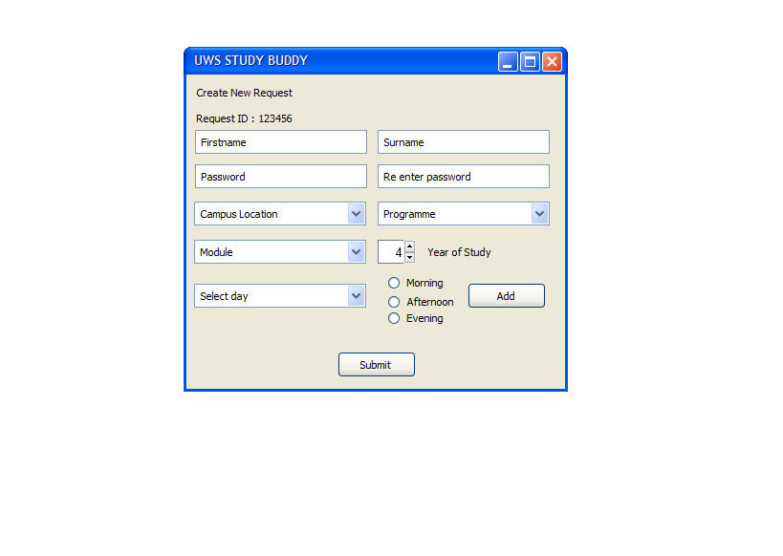
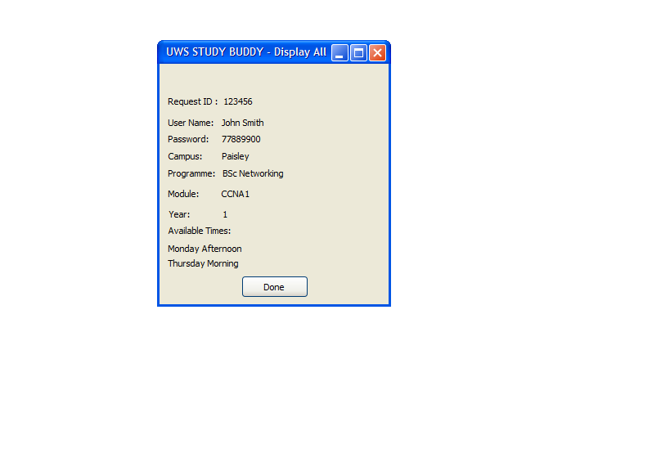
Example Interface (GUI)

